Slide 1
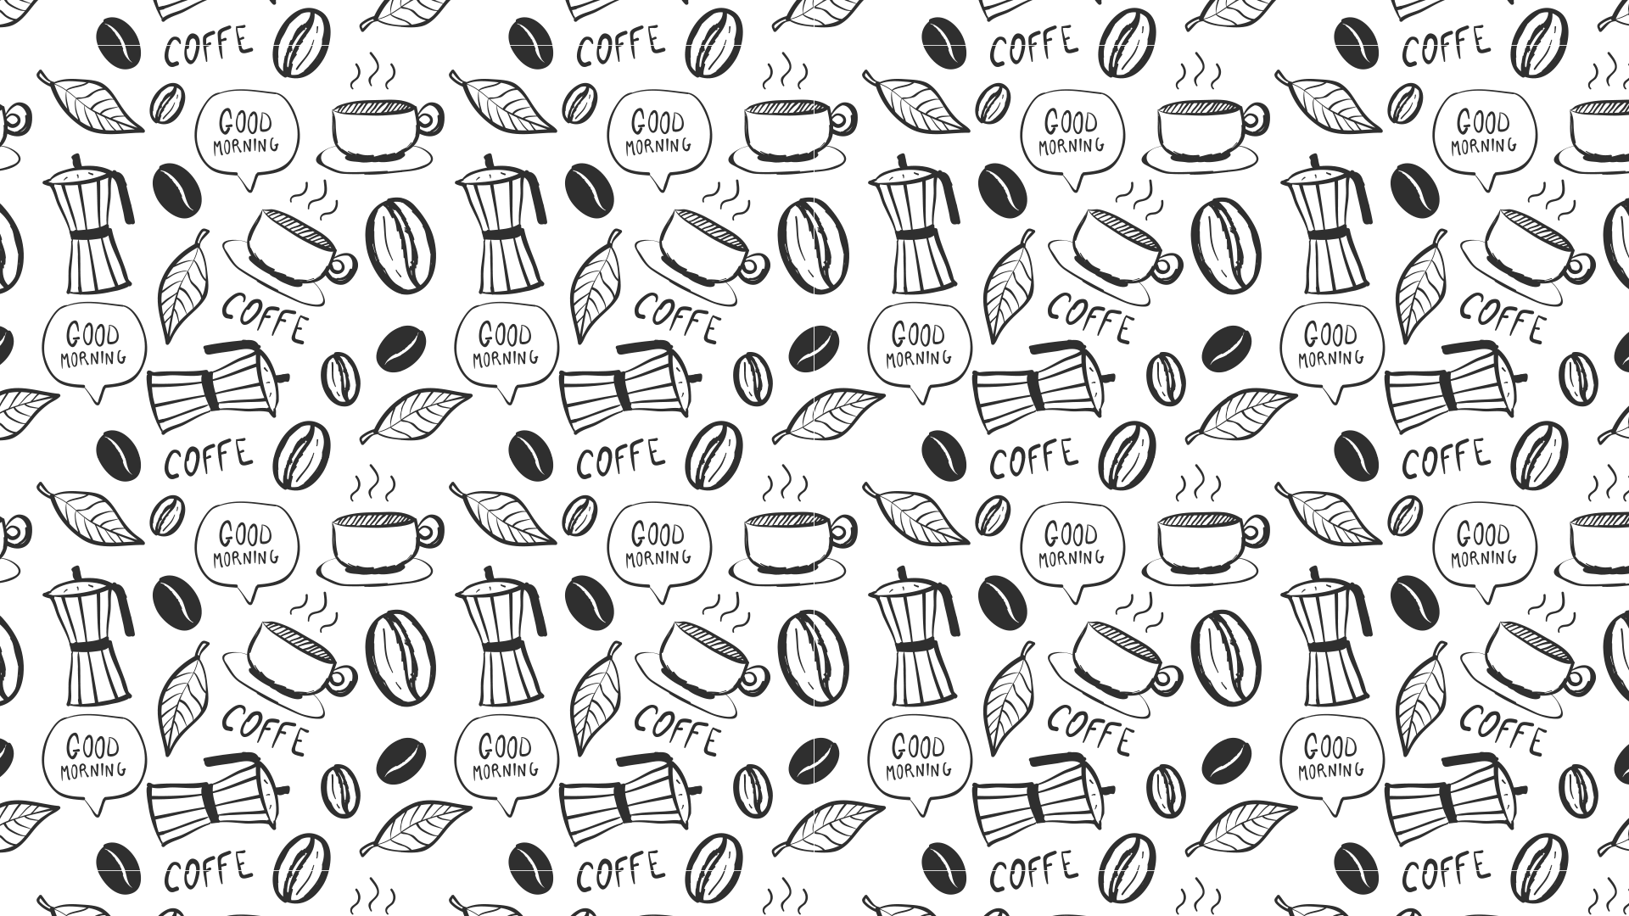

STARBUCKS

Slide 2
Outline
Project Background
Assumption
Data Readiness
Data Analysis
Observations
Conclusions
Validations (Statistical determination)

Slide 3
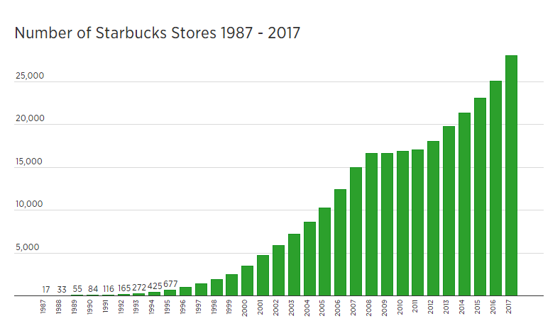
Starbucks has had an amazing growth in the past 30 years

Slide 4
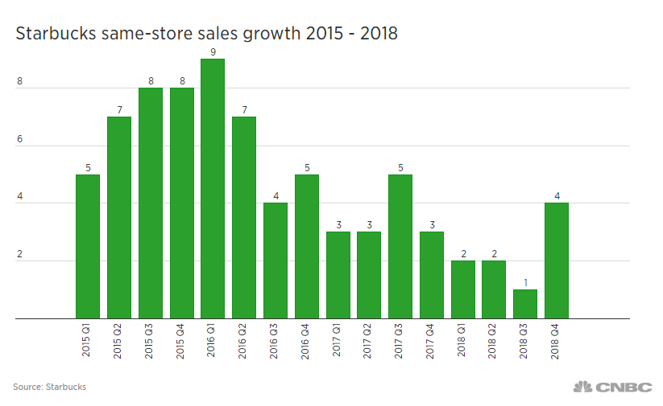
However in the recent past same-store sales has slowed questioning if growth of Starbucks has started slowing down
Same Store growth %

Slide 5



Is Starbucks market saturated or are there opportunities for more Starbucks in the United States ?
Is Starbucks market saturated or are there opportunities for more Starbucks in the United States ?

Slide 6
Assumptions
Study is focused on United States Only.
The data selected and analyzed acts as a primary filter and allows for further focused investigation (which is not in scope)
It is assumed that Starbucks will continue to evolve, attract and retain its customer base by offering value driven engaging services and products
Analysis does not include competition information and its impacts
Other significant factors such as Tax Incentives or Impact of Weather (colder conditions are not evaluated)

Slide 7
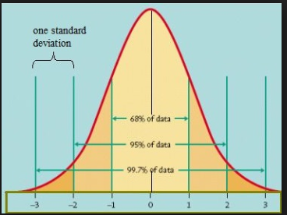
Our Analysis attempts to analyze key characteristics of existing Starbucks locations by matching at Zip Codes
C E N S U S D A T A
Per Capita Income
Median Age
Zip Codes
Employed Rate
Household Income
I N N E R J O I N
Existing Starbucks location Information by Zipcode
Zip codes
Zip codes
Aggregated Mean &
Standard Deviation for each Key variable
Source: Kaggle
Source: Census Data
Dataset - 2
Dataset - 1

Slide 8
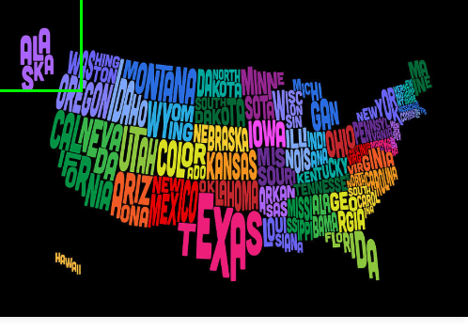
And explore if similar characteristics exists across other non Starbucks Zip Codes

Slide 9


Key Characteristics Analyzed
Median Age
Per Capita Income
Household Income
Employment Labor Force

Slide 10
Data Readiness
Data Cleansing
Derived 5 digit Zip Code from Postal Code
Removed Null Values in Postal Code
Standardized Store Brand Names
Removed Negative Values
Techniques Used
Sub string (0-4) used to extract
API for Zipcode Lookup (Geocode) - to populate missing zipcode based on address
Check for Values which are >= 0
Reviewed ‘Brand Name’ Variable to standardize (Starbucks, Teavana, Coffee Holdings..)

Slide 11
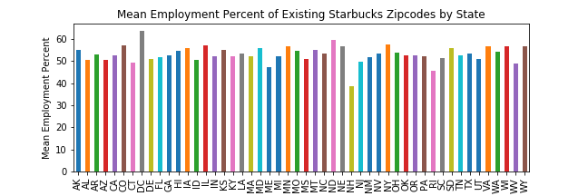
Each of the key characteristics we analyzed at the state level provided insights

Slide 12
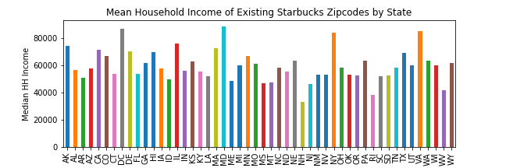
Each of the key characteristics we analyzed at the state level provided insights

Slide 13
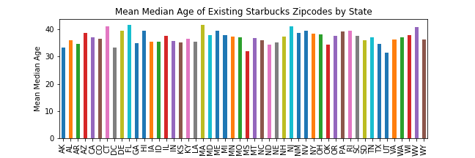
Each of the key characteristics we analyzed at the state level provided insights

Slide 14
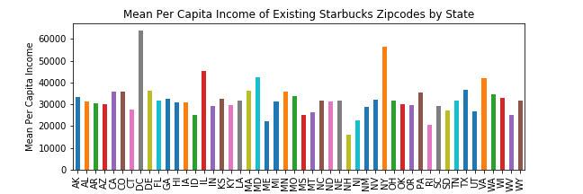
Each of the key characteristics we analyzed at the state level provided insights

Slide 15
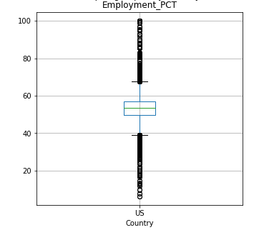
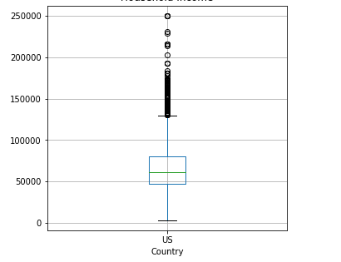
The Mean and Standard Deviation of each of the 4 Key characteristics of the existing Starbucks Zip codes were evaluated
Household Income
Mean : 65,912.27
Standard Deviation : 25,717.09
Mean : 53.74
Standard Deviation :7.67

Slide 16
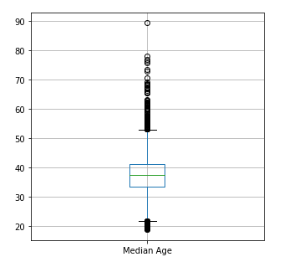
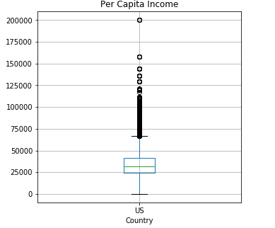
And formed the basis of analyzing the market area
Median Age
Mean : 37.47
Standard Deviation : 6.83
Mean : 35,435.68
Standard Deviation : 17,505.88

Slide 17
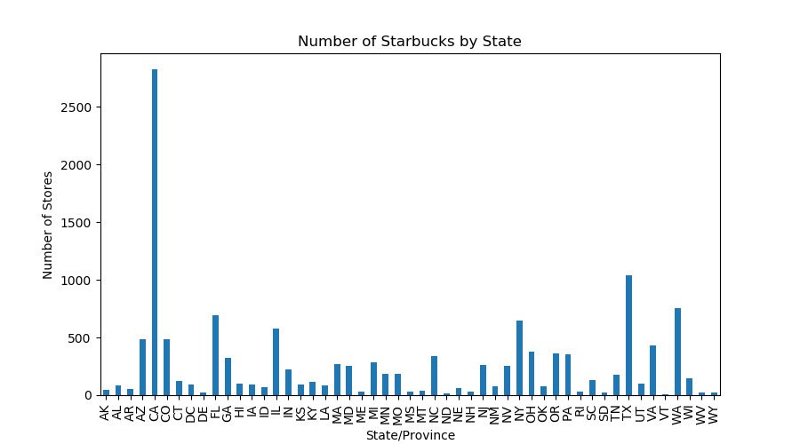
About 13K Starbucks stores are operated in the US spread across the country, in predictable manner

Slide 18
We represented the zip codes with existing Starbucks as a visual baseline

Slide 19
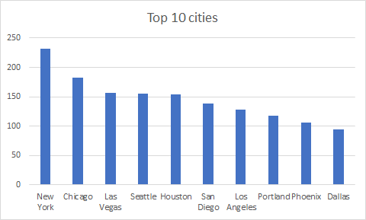
The top 10 cities for Starbucks are well spread across the US

Slide 20
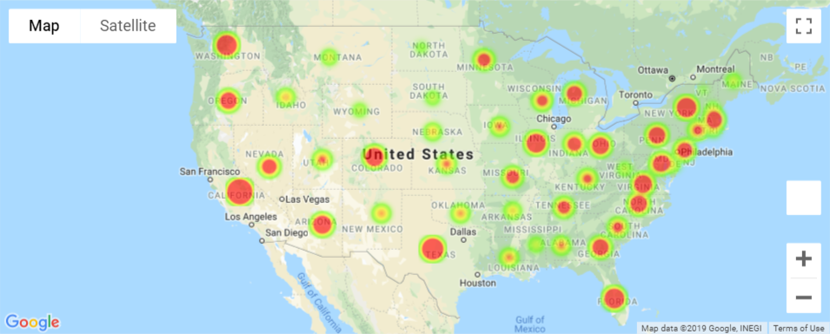
States with larger metro areas dominate the existing 13K Starbucks

Slide 21
Armed with the analysis, we focused on identifying new zip codes which matched existing Starbucks location characteristics
Technical Details of how this was accomplished
Approach
Find the Mean and Standard Deviation of the 4 variables for Zip codes that have Starbucks.
Check if the variable value for the Zip codes that do not have Starbucks is within 1 Standard Deviation of the mean.
Get the list of zip codes that are within 2 miles of existing Starbucks.
Compare recommendations with above list and eliminate the Zips that match.
Use a Zip to lat-long file for plotting.
Conduct independent ttest on the variables to check if there is significant variance between zipcodes that have Starbucks and that do not.
Mean
House hold Income
Per capita Income
Employment Percent
Median Age

Slide 22
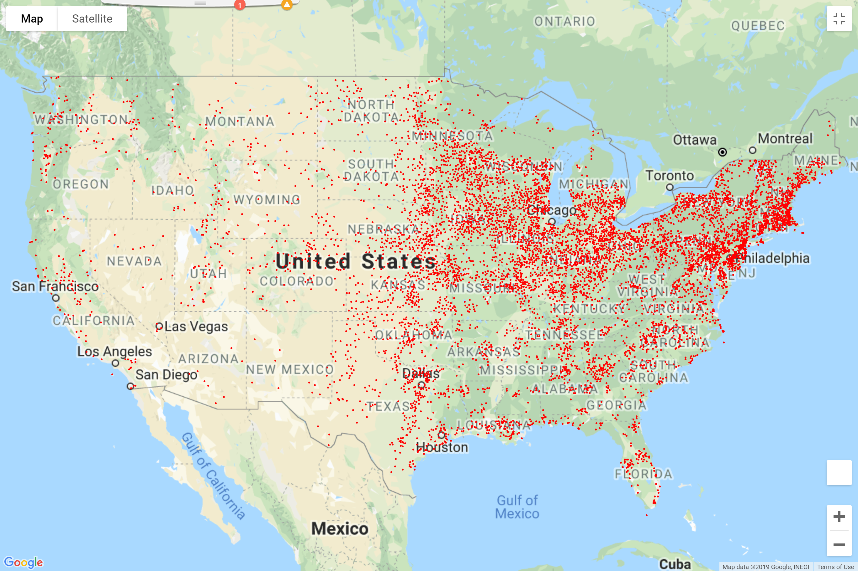
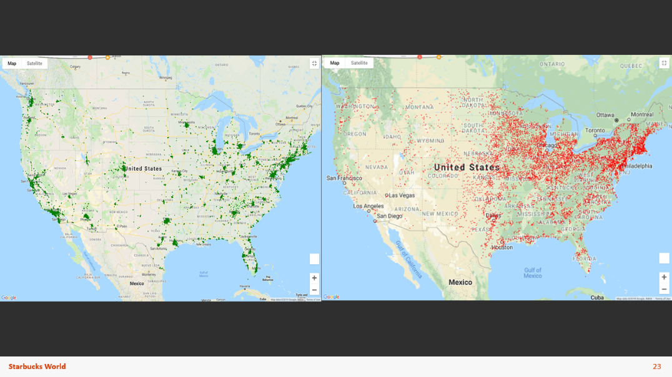
A visual comparison of potential new locations provides a broad overview of the opportunity compared to existing Starbuck location
Existing Starbucks
Potential New Starbucks

Slide 23
Conclusion: Abundant market exists! Over 7K suitable new zip code locations were identified

Slide 24
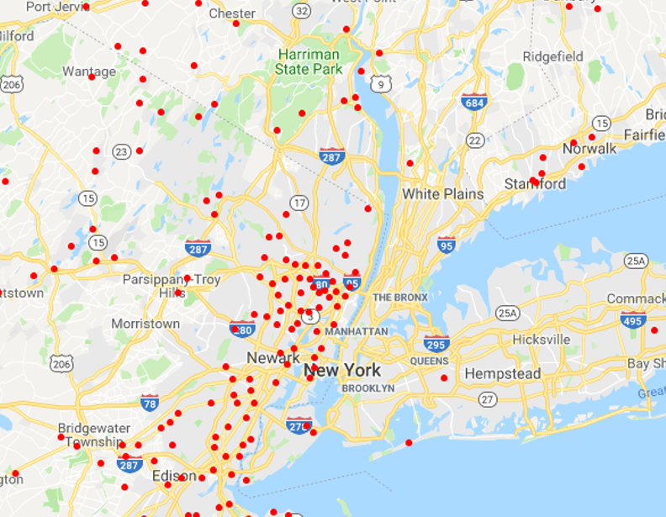
Analyzing further - With 232 stores in New York City, our process, not surprisingly projected no new potential zip codes.

Slide 25
Looking into the distribution of potential market by zip code at State level, insights emerge allowing for further evaluation
CA= Saturated
WA = Saturated
PA = High Potential
NJ = High Potential

Slide 26
Our Hypothesis :
Hypothesis:
Median Household Income varies significantly between the zip codes which have a Starbucks vs. those which do not
Null Hypothesis:
Median Household Income does not vary significantly between the zip codes which have a Starbucks vs those which do not
Test Conducted:
Upon comparing the Household Income between zipcodes that have and do not Starbucks, it was determined that there is considerable variance in Household Income. This was determined using independent t-test, for which the p value was value 0.05.

Slide 27
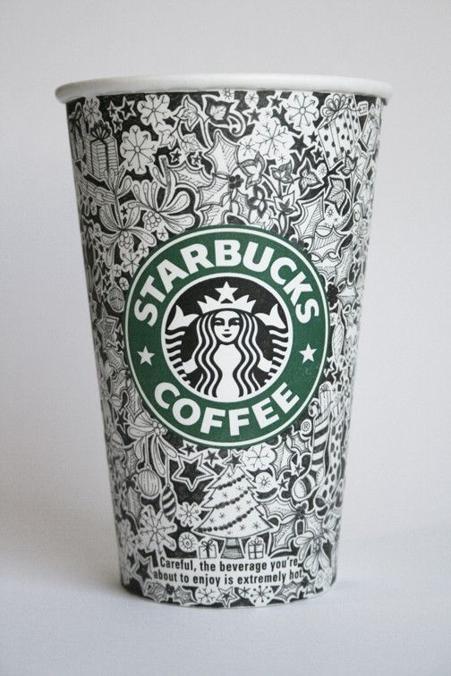




THANK YOU!
Luis
Amit
Renju
Abdul
The LARA Team

